Slide 1
Dimensional Modeling REVIEW
ICT394 BI Application Development

Slide 2
What is Dimensional Modeling: TOPIC 4 Tutorial 4 Review
Today we will start the Tutorial session by reviewing the following Tutorial 4 Topics in class
What is a Dimension Table?
What is a Fact Table?
What is a Star Schema?
What is a Relationship?
What is a Denormalized Table?

Slide 3
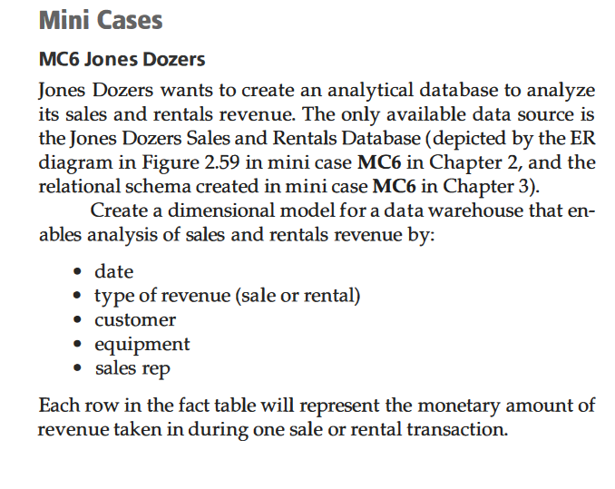
Dimensional Modeling: Tutorial 4 Review
Quick review of the tutorial question
Tip: start with a pen and paper (let’s do it on the Whiteboard)
Some tables are used as slicers (e.g. slice by equipment), some tables are used as values (eg total_revenue)
Slicer (filter) tables are called Dimension Tables
Value (measures) tables are called Fact Tables
Fact tables have less columns than dimension tables, but more rows of data
The Tutorial question is asking you to create a star schema with these five (5) dimensions tables
And, create one Fact table that stores the amount of revenue (by revenue type – either sale revenue or rental revenue

Slide 4
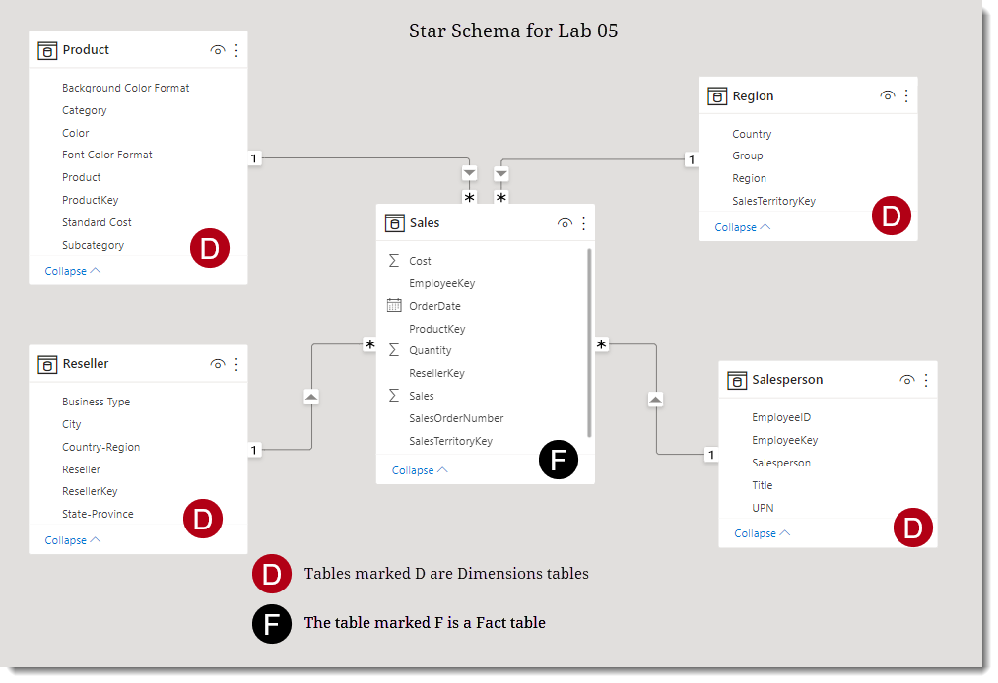
Dimensional Modeling: Tutorial 4 Review
What is a Star Schema?
A dimensional modelling technique where tables are designed as either dimension or fact.
In a star schema
Dimensions describes business entities.
Fact tables store observations (as values).
We will create this star schema on the right in Lab 05
In the dimensions tables marked D, which ones are the surrogate key?

Slide 5
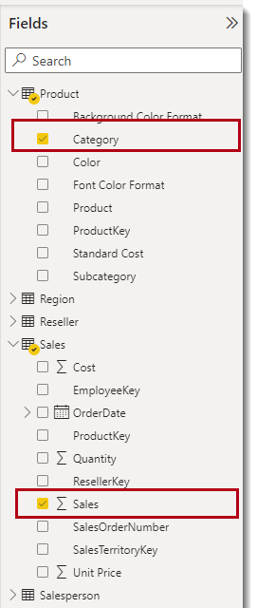
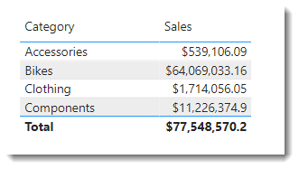
Dimensional Modeling: Tutorial 4 Review
What is a Dimension Table?
Describes business entities eg Product.
This is a dimension table in Power BI
When filtering data, we use data from the dimension tables
For example, here the sales data (from sales fact table) is filtered by category (from the Product dimension)
Dimension tables are typically smaller, thus the number of items that we can filter and group on are limited.
For instance, a product contains only so many categories.

Slide 6
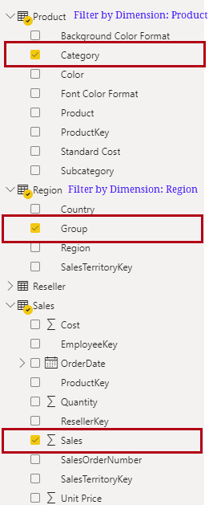
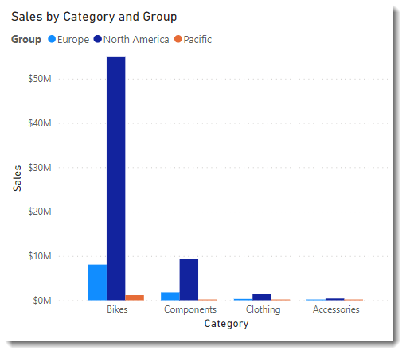
Dimensional Modeling: Tutorial 4 Review
Dimension Table cont’d
filtering from the dimensions tables – here is another query example
Sales (from Sales Fact Table)
filtered by Category (from the Product dimension table)
and by Group (from the Region dimension table)

Slide 7
Dimensional Modeling: Tutorial 4 Review
What is a Fact Table?
Store observations eg total_sales, temperature, stock balances, or events such as individual transactions
Fact tables are usually much larger than dimension tables
Contains dimension key columns that relate to dimension tables,
numeric measure columns
dimension key values determine the granularity of a fact table – eg Transaction ID

Slide 8
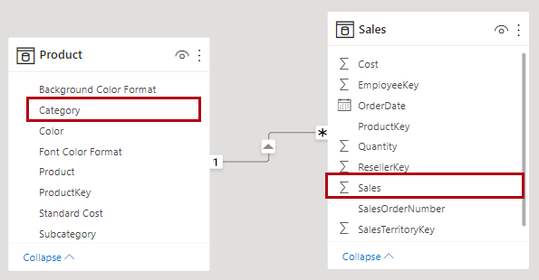
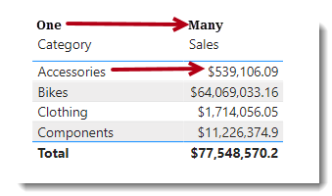
Dimensional Modeling: Review Relationships
What is a Relationship
Relationships propagate filters to other tables. The filter propagates towards the arrow…
Dimension to Fact table relationship is usually a one-to-many – eg, a product category can have many sales…
Creating relationships helps avoid denormalized tables, discussed in the next slide…

Slide 9
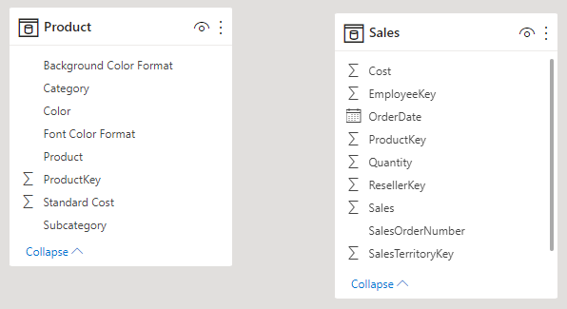
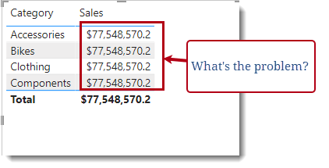
Dimensional Modeling: Review Relationships
What happens when there are no relationships between tables?
Can you apply filters?
The filter propagates towards the arrow – no relationship no filtering…
Question: What is the possible issue with the Sales values in the table shown on the right?
We will create relationships and observe filter behaviors in Power BI Lab 05 today

Slide 10
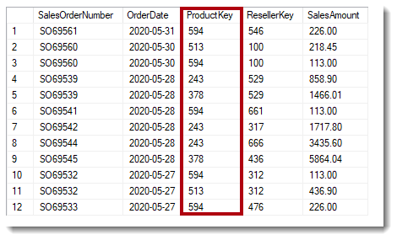
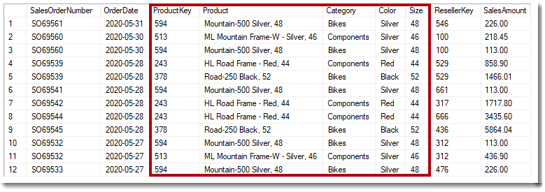
Dimensional Modeling: Review Denormalization
First, what is a normalized table?
Describes data that is stored in a way that reduces redundant data
The first table shown here is considered normalized as it stores only keys (e.g., product key, reseller key)
What is a denormalized table?
In the second table shown here, instead of storing just the product key, the table stores other product data.
This is considered denormalized.
Use denormalized tables sparingly
What is the purpose of denormalization then and when should you denormalize a table?

Slide 11
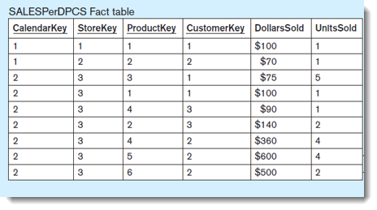
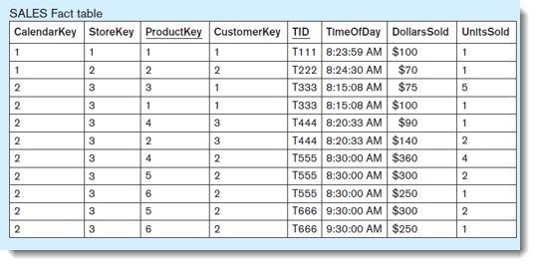
Detailed and Aggregated Fact Tables: Tutorial 4 Review
In Topic 4 we covered the concept of Aggregation
Fact tables in a dimensional model can contain either detailed data or aggregated data
In detailed fact tables each record refers to a single fact
In aggregated fact tables each record summarizes multiple facts
Review Question (important for Assignment 1):
Which of these two tables is a detailed fact table? Why?

Slide 12
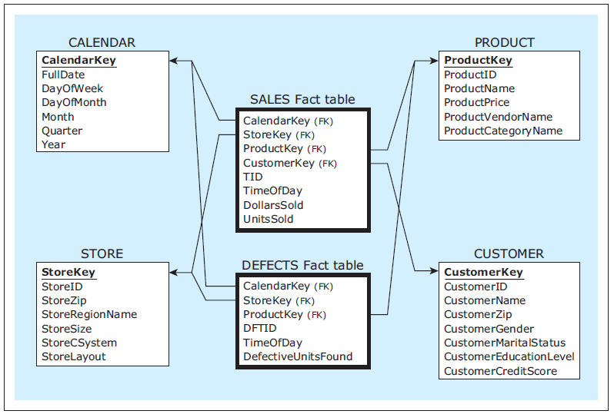
Review MCQs: Dimensional Modeling
What type of Dimension Model is shown here?
Star Schema
Snowflake
Constellation
A dimensional model with multiple fact tables is referred to as a constellation or galaxy of stars

Slide 13
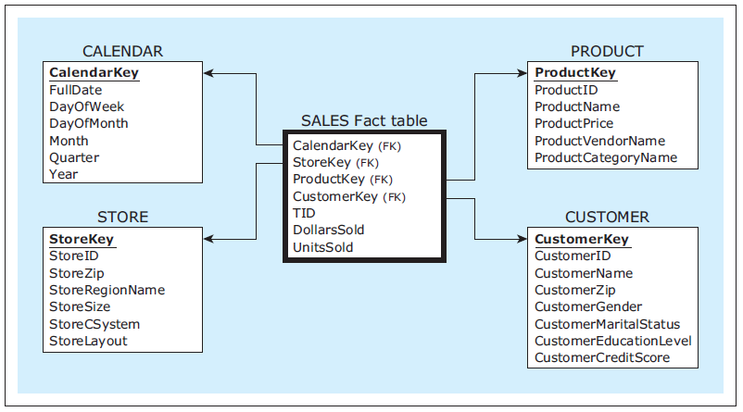
Review MCQs: Dimensional Modeling
What type of Dimension Model is shown here?
Star Schema
Snowflake
Constellation
In the star schema, the chosen subject of analysis is represented by a fact table in the center, representing the chosen subject

Slide 14
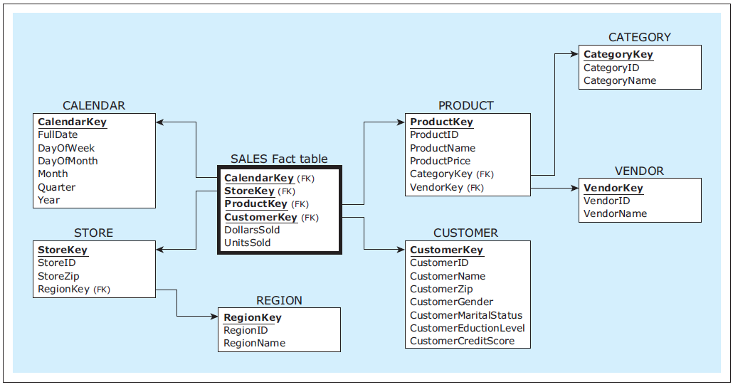
Review MCQs: Dimensional Modeling
What type of Dimension Model is shown here?
Star Schema
Snowflake
Constellation
Is a star schema, that contains the dimensions that are normalized.
Not usually used in dimensional modeling because normalization is usually not necessary for analytical databases.

Slide 15
Business Analytics Review
ICT394 BI Application Development

Slide 16
Topic 07: Lecture Outline
What is Business Analytics?
Types of Business Analytics
Types of Reports
SMART Goals
Developing a Business Analytics plan
Topic Summary
This topic contributes to the following unit learning outcomes:
Demonstrate an understanding of the role of BI in organisations
Present analyses of data using a number of different techniques

Slide 17
Business Analytics
A broad term, defined differently by different authors
Stubbs (2013) provides such a definition:
“analytics can be considered any data-driven process that provides insight” (p.5)
Seddon et al (2016):
“the use of data to make sounder, more evidence-based business decisions”

Slide 18
How does Business Analytics provide insight?
Reporting – summarization of historical data
Trending – identification of patterns
Segmentation – looking for similarities
Predictive Modeling – predicting future events based on historical data
**We’ll be doing all this in some form, in Power BI

Slide 19
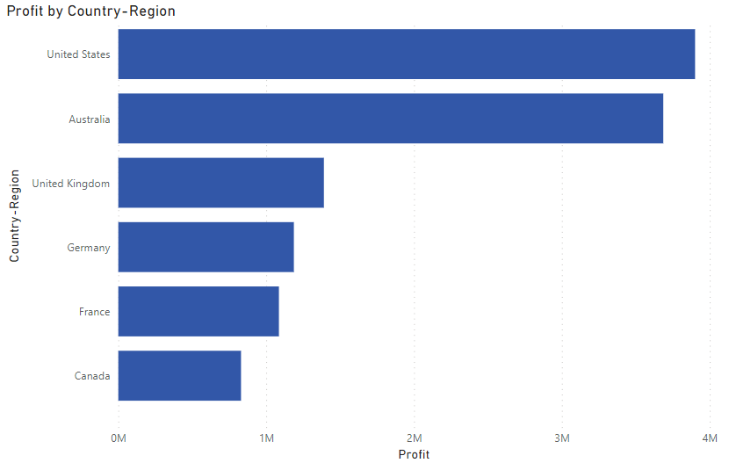
Types of Business Analytics: Descriptive Analytics
aka Reporting
What is happening and understanding the underlying trends and causes
Relies on consolidated data sources (e.g., BI target database/data warehouse)
Relies very heavily on visualization
Reflection Questions
From the Bar Chart – can we tell why Canada has the lowest Profit?
What other descriptive analytics can you use to describe the data in Assignment 2?
This is an example of descriptive analytics generated from Lab 08 data – just describing data, no conclusions can be drawn.

Slide 20
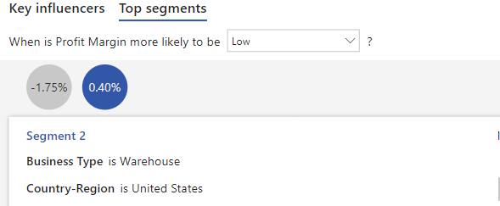
Types of Business Analytics: Predictive Analytics
Aims to determine what will happen in the future
Generally based on statistical or machine learning techniques and other techniques that will often fall under data mining
Often used to predict churn, products a customer is likely to buy next, creditworthiness assessment
Here is an example from Lab 08 – you will be performing in class today
From this example, you can predict when Profit Margin is likely to be low. Here, the Profit Margin is likely to be low if the Business Type is Warehouse and the Country is United States.

Slide 21
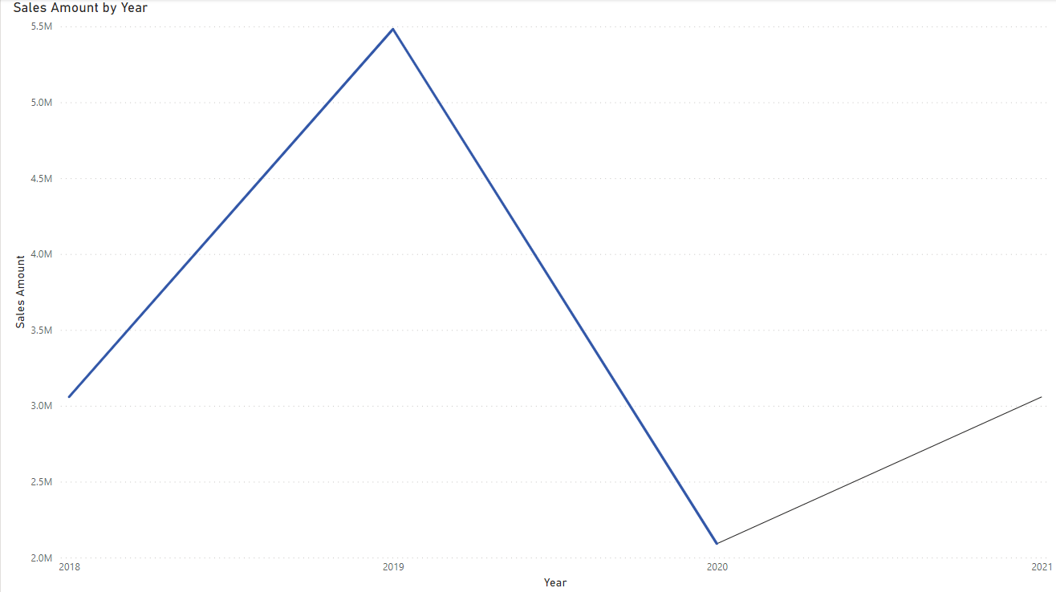
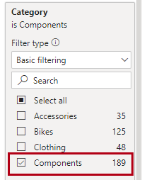
Types of Business Analytics: Prescriptive Analytics
Goal is to recognize what’s happening, or forecast and to make decisions for best possible performance
Goal is to prescribe/recommend
The types of recommendations may be Yes-No or recommend a production amount
Here is an example of Forecasting – we will perform this in Lab 08 today –
Reflection Question: What prescriptive analytics can you use to provide insights in Assignment 2?
From this example from Lab 08, you are performing a forecast to determine possible future sales revenue -here the results suggest an increase in revenue (black line is the forecast) for “Components”
From the results you can prescribe increasing production for “Components”

Slide 22
Types of Business Analytics: Business Analytics
Business Analytics is about developing or creating insight from data – How?
In order to develop insight, we need to be sure that we understand what it is we are trying to do…
What problem are we trying to solve? For example, in the following...
Using historical data about COVID infections going back to 2020, project (forefast) the number of infections in 2024 – Decision: order more, or order less test kits?

Slide 23
Types of Business Analytics: Advanced Analytics
Focus is on
WHY things are happening
WHAT things are likely to happen (e.g. forecasting)
Requires more complex toolset
Operations research
Statistics
Multivariate analyses
Decision trees
Regressions

Slide 24
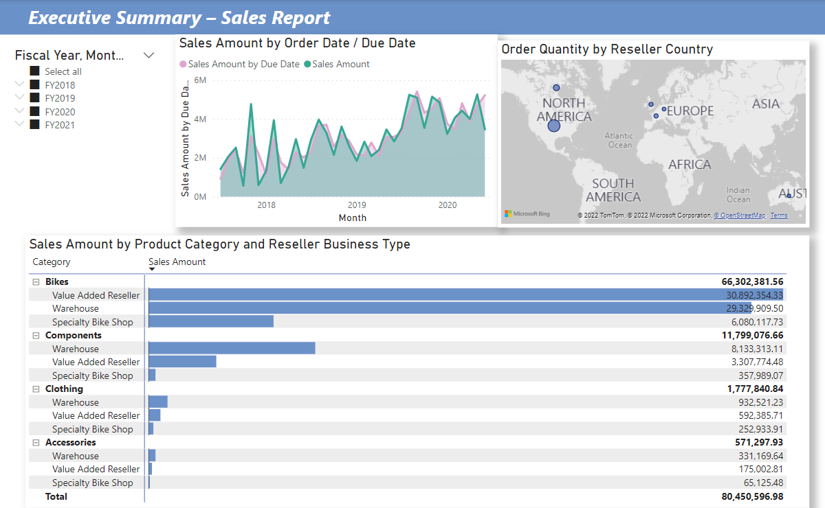
What is a report and Dashboards?
Report is a document that contains information relevant to the domain of interest
Used in management decision making
Will use data from a variety of sources
Share insights more effectively with a range of performance indicators on a single page
**We’ll be creating this advanced report today, in Lab 07 in Power BI

Slide 25
Visualization Best Practices Review
ICT394 BI Application Development

Slide 26
Choosing the right chart type
Trends over time
Ranking
Correlation
Distribution
Part to whole
Geographical data

Slide 27
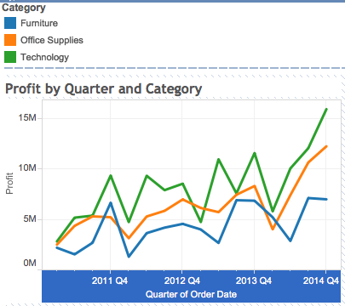
Choosing the right chart type: Trends over time

Slide 28
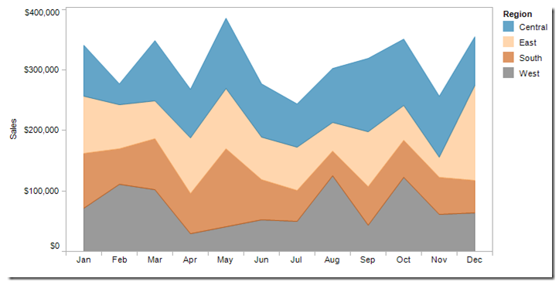
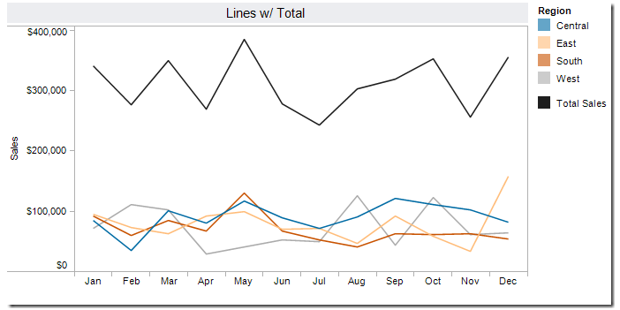
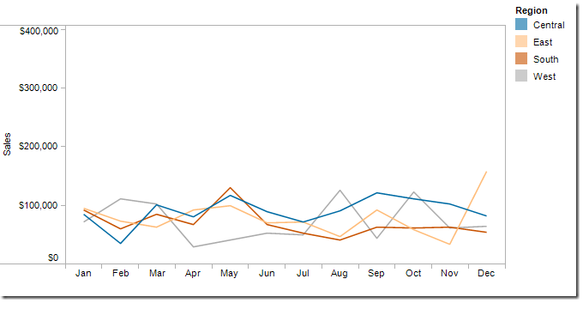
Choosing the right chart type: Trends over time
Area Chart vs Line Chart
Area charts present cumulated totals using numbers or percentages
This stacked area charts show the trends and the contribution
Can be confusing – may not show trends as well as line charts
Line charts show trends over intervals of time – a time series
Better at displaying trend over time for each region than area charts
This example shows Total Sales as well
Note how the Total Sales matches the cumulated totals in the area chart

Slide 29
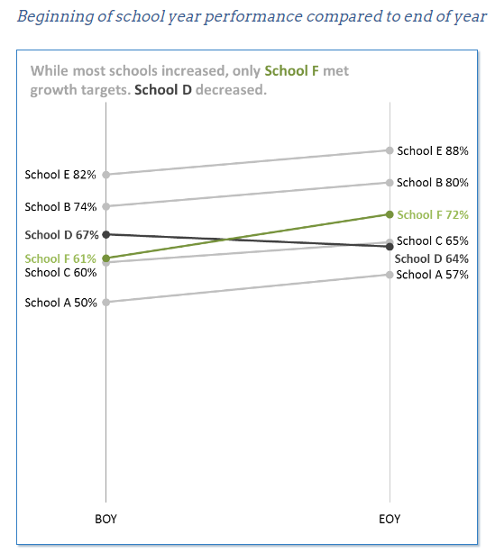
Choosing the right chart type: Trends over time
Slope Chart
Useful for
Compare categories while
Displaying changes in rank over time
Use only when you want to focus on beginning and end points
https://www.betterevaluation.org/evaluation-options/slopegraph

Slide 30
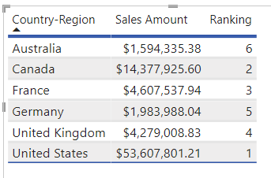
Choosing the right chart type: Ranking
Tip: to rank values in Power BI, you can explore the RANKX function, then create a relevant visualization (see example)

Slide 31
Choosing the right chart type: Correlation
Relationship between two variables
During analysis you will be looking at relationship between two measures
Scatter plots without a trendline
Scatter plots with a trendline

Slide 32
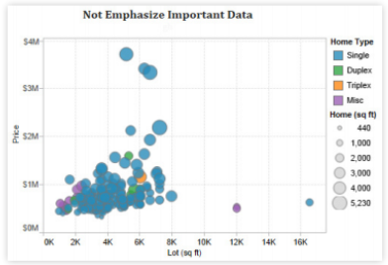
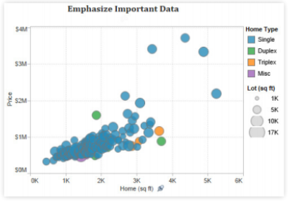
Creating effective views: Emphasize the most important data
The visualization tools we use are powerful and allow us to perform sophisticated analysis…
For e.g., ability to choose where the measures are positioned in your graph
X or Y-axis
Or colour, size or shape
An important rule is that the more important data should be shown on the x and y-axes
Lot Size
Home Size

Slide 33
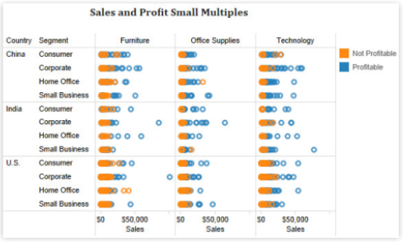
Creating effective views: Avoid overloading your graphs
The tools allow us to do a whole heap of stuff that may or may not be useful
Overloading is a common mistake
Ending up with information that is not immediately obvious to others

Slide 34
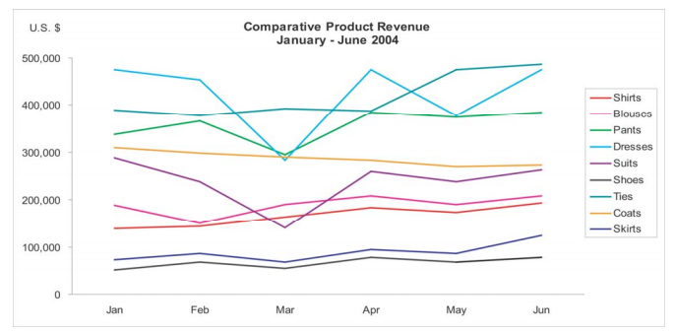
Limit the number of colors and shapes in a single graph
Similar to the previous one, and as we have discussed before, there are limits as to what can be easily processed and understood
Limit the number of colors and shapes in a single graph to 7-10
Topic Review
Revisit the topic of Gestalt Principles
Pre-attentive attributes
Used to reduce cognitive load

Slide 35
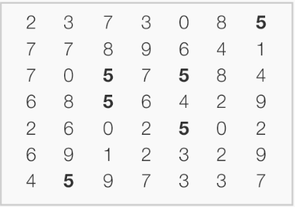
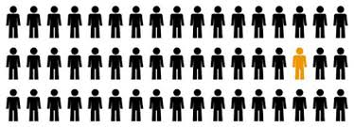
Review: Gestalt Principles and Pre-attentive Attributes
There are six principles that are of interest to us in terms of designing effective visualizations
Proximity
Similarity (image below shows an example of similarity)
Enclosure
Closure
Continuity
Connection
Few (2012) suggests there are three main categories of pre-attentive attributes that are relevant to us
Form - Length, Width, Orientation, Shape, Size and Enclosure
Color
Spatial position
This example applies both Gestalt and Pre-attentive

Slide 36
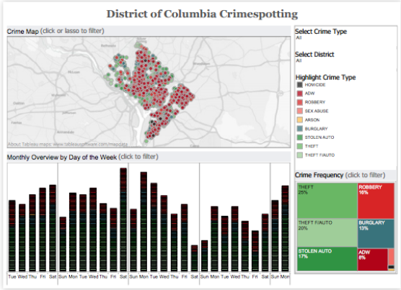
Designing holistic dashboards, reports: General design principles
Most important graph at the top or top left
If users are expected to move from one graph to another, then go top→bottom and left→right with the final view at the bottom right
Limit the number of graphs to three or four
Avoid using multiple color schemes
Group filters together
Put the legend(s) with the filter(s)

Slide 37
Perfecting your work
Colors
Work together without clashing
Less than 7-10
Fonts
Consistent use throughout
No more than 3 different ones on a dashboard
Labels
Clear, concise
Placement
Levelling
Tooltips
Useful?

Slide 38
Evaluating your work
How do I know my visualization is any good?
You need to ask yourself a number of questions
What questions are you trying to answer?
Do you have the right chart type for your analysis?
Are your graphs effective?
Is your dashboard holistic?
Are there other things you could do to polish your work up?

Slide 39
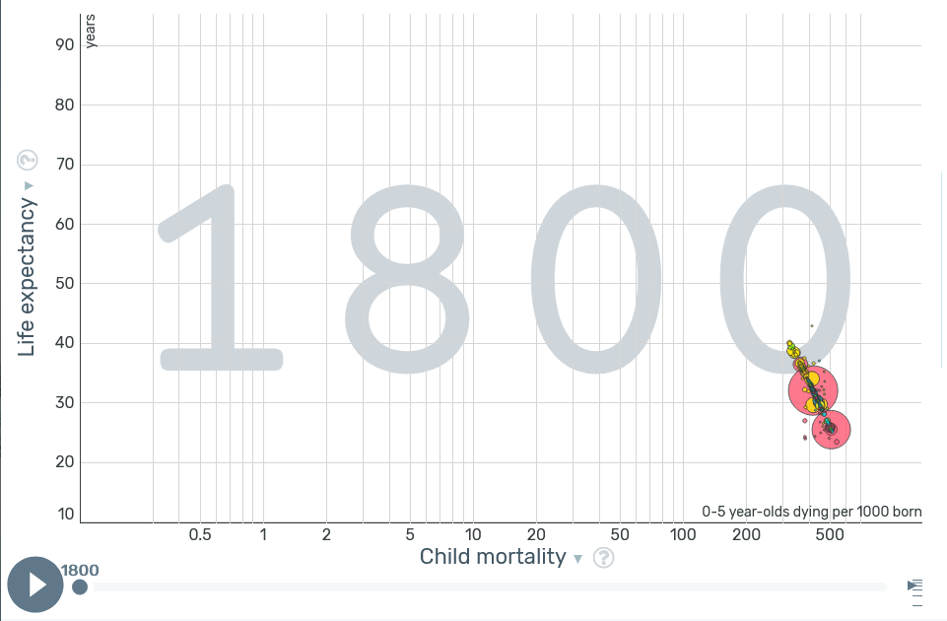
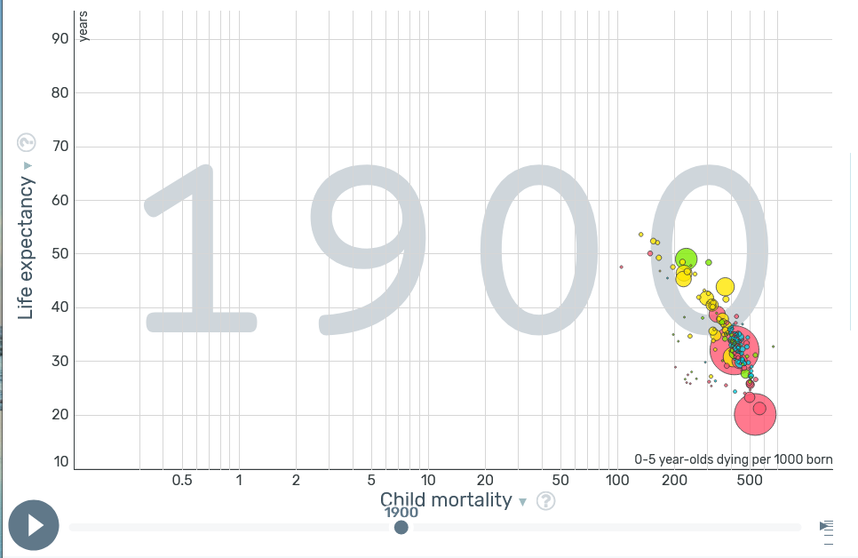
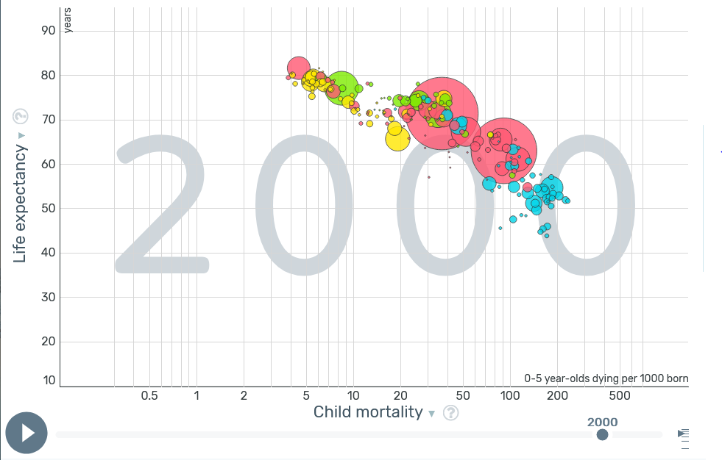
Presenting your visualization
Purpose is to tell a story using visuals rather than words? For example
What story is the visualization attempting to tell?
Is it analysis, communication, monitoring or planning (or something else)?
Is the analysis descriptive, predictive, prescriptive?
What type of tools is it using, e.g., text, bar chart, line chart etc?
How much effort do you need to put in to understand the story?
What other ways do you think this story could be told?

Slide 40
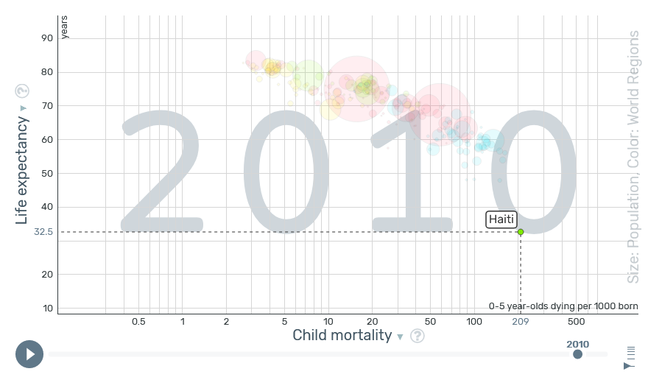
Presenting your visualization: Additional Tips
Instead of explaining one visual at a time, try the following
First, identify patterns or trends in your data – e.g., trend over time
Draw comparisons – e.g., compare categories, countries e.g., Singapore vs UAE vs Australia
Are there any correlations between variables? Look for interesting relationships
Anything out of the ordinary? Look for outliers – e.g., Haiti appears to be an outlier, life expectancy suddenly drops in 2010 – why?
For the above explain the meaning of the data

